Slide 1
CPT Workshop

Slide 2
Curriculum Practical Training
An employment that is integral part of an established curriculum (receive academic credit)
Part-time during academic sessions, full-time on vacations
Available only prior to the completion of your degree program
No fee to apply

Slide 3
CPT Authorization
Must have authorization from International Student Office before you begin a paid or unpaid internship
Beginning CPT without proper authorization is a violation of immigration regulations and will have serious consequences

Slide 4
Eligibility Requirements
Must have been lawfully enrolled on a full-time basis for at least two consecutive terms
Have a job offer
Be in lawful F-1 status at the time of applying for CPT

Slide 5
Does CPT affect OPT?
Part-time CPT does not affect your OPT
You have to work more than 365 days of Full-Time CPT to become ineligible for OPT

Slide 6
Work on Campus and do CPT
If you do both, make sure you do not exceed more than 20 hours of work per week in TOTAL, while school is in session
Work full time when school is not in session

Slide 7
Procedures for Application
The completed "Supervising Department Chair Recommendation for CPT"
A copy of your course registration showing the internship course you are taking in the semester you are applying for CPT
A copy of the job offer letter you obtained from the employer

Slide 8
Form I-9 – Work Authorization
Your SEVIS I-20 with CPT authorization on page 3 is a proof of work authorization. Your passport can be used as a proof of identity.
Social Security Card

Slide 9
How to find Job?
Career Center at St. Francis College

Slide 10
FACEBOOK-LINKEDIN-TWITTER

Slide 11
CREATE THE RIGHT ONLINE PRESENCE
Have a professional picture
Keep your brand consistent
Use social media in the right way
Always write positive stuff online; WORDS STICK!

Slide 12
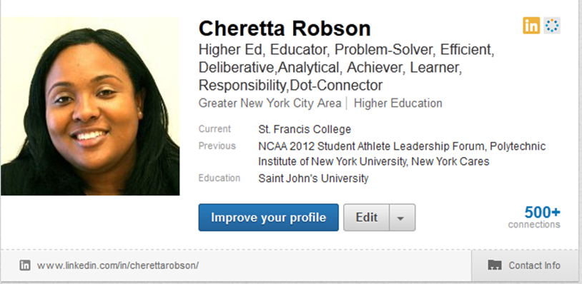
Linkedin

Slide 13
OPTIMAL RESUME
Visit www.sfc.optimalresume.com
Register with your @sfc.edu e-mail
Alumni: a password is required from the Career Development Center
Build Resumes and Cover Letters
Practice Interviewing
Easy Download to PDF
Easy to Share

Slide 14
SFC JOB BANK
The SFC Job Bank is a self-managed job database through the Career Development Center with jobs and internship listings for students and alumni. The SFC Job Bank also is connected with LinkedIn and Facebook to see network connections to job/internship postings.
Access the following website: www.sfc.edu/job_bank or go into your MySFC Portal and click on the Career Center tab. You will see Online Resources. Click on the SFC JobBank link.
Current Students: Log into system using your Username and Password
Update your profile
Put your cursor over My Account and select My Profile.
You will see sections containing Personal Information.
Each section will have an [Edit] link. Click on this link or on the tabs at the top of your profile to edit fields within the section.
Carefully go through each section and complete all of the fields making sure to click on the Save button. Required fields are marked with an asterisk (*).
NOTE: The more detailed you fill out your profile, the better we will be able to assist you.

Slide 15
CAREER CENTER SERVICES
Career Advisement
SFC Job Bank linked with internships.com and indeed.com
Optimal Resume
On-campus recruiting program
Career + Graduate school fairs
Resume writing
Interviewing skills
Internship listing
Job search tools
Self-assessment tools
Career field resources
Professional + Graduate school information
Workshops and events

Slide 16
Contact Us
Career Development Center
Room 2311, 2nd Floor
718-489-5360
careercenter@sfc.edu
Center Hours: Monday-Friday 9AM – 5PM

